Slide 1
What does a Data Scientist do?
Find patterns and trends in datasets to uncover insights
Create algorithms and data models to forecast outcomes
Use machine learning techniques to improve the quality of data or product offerings
Communicate recommendations to other teams and senior staff
Deploy data tools such as Python, R, SAS, or SQL in data analysis
Stay on top of innovations in the data science field
Source: https://www.coursera.org/articles/what-is-a-data-scientist

Slide 2
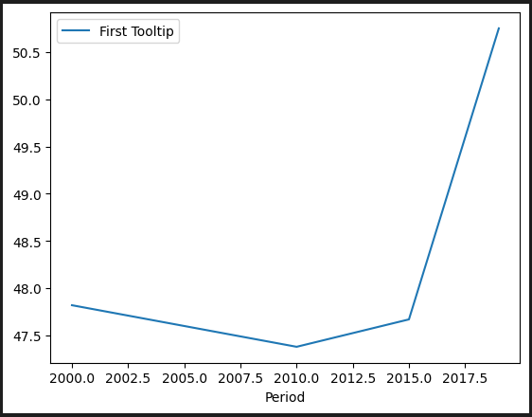
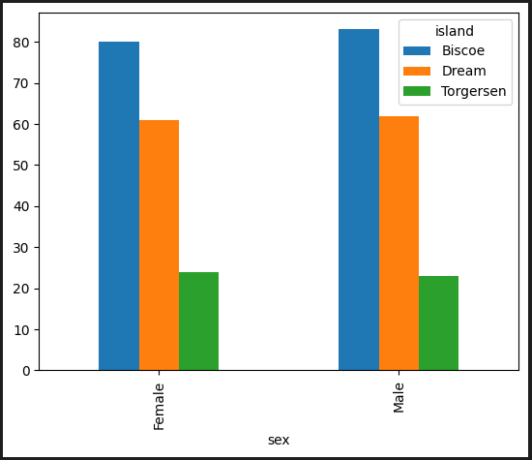
Find patterns and trends in datasets to uncover insights
The estimated lifetime of someone born in Lesotho increased after 2015. The question is why did this happen?
There is no difference in sexuality across the different islands. This pattern suggests that the island on which the penguin is living doesn't have any effect on its sexuality.

Slide 3
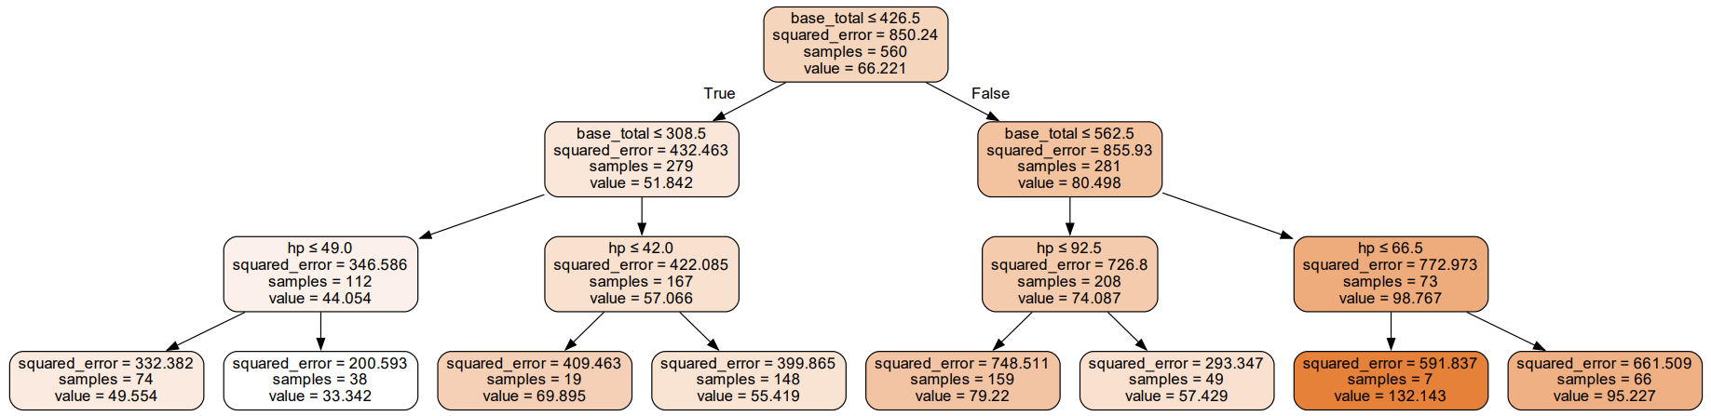
Create algorithms and data models to forecast outcomes
The decision tree is based on an algorithm. We can estimate the speed of a Pokémon based on the total points of its attributes and its HP.
This algorithm also uses machine learning to increase the quality of the dataset.

Slide 4
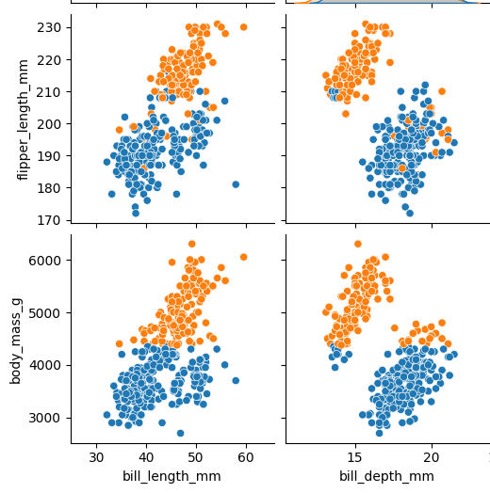
Create algorithms and data models to forecast outcomes
These clusters are created using the algorithm called K-means, which is a popular algorithm for easily understanding large datasets. However, it is possible to make errors in the selection of the initial cluster centroids, so it is very important to verify the results carefully.

